Slide 1
Yvonne Goodfellow
Membership and Community Manager
West Scotland

Slide 3
FUNDING PYRAMID
NATIONAL
REGIONAL
LOCAL

Slide 4
LOCAL FUNDING
NATIONAL
REGIONAL
LOCAL

Slide 5
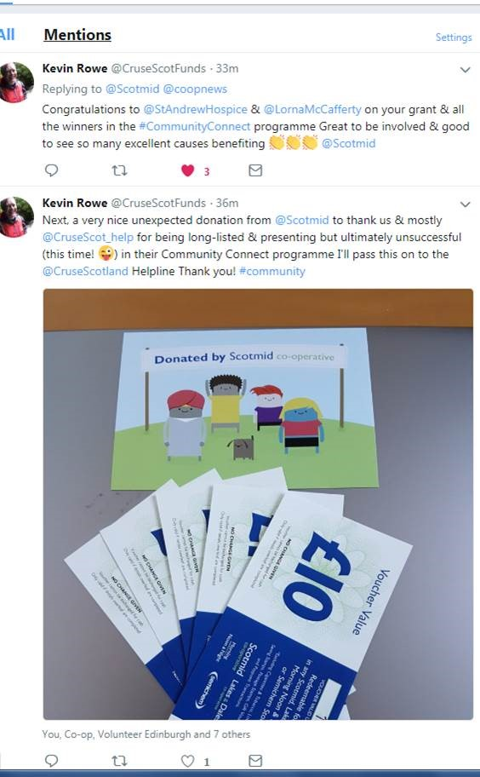
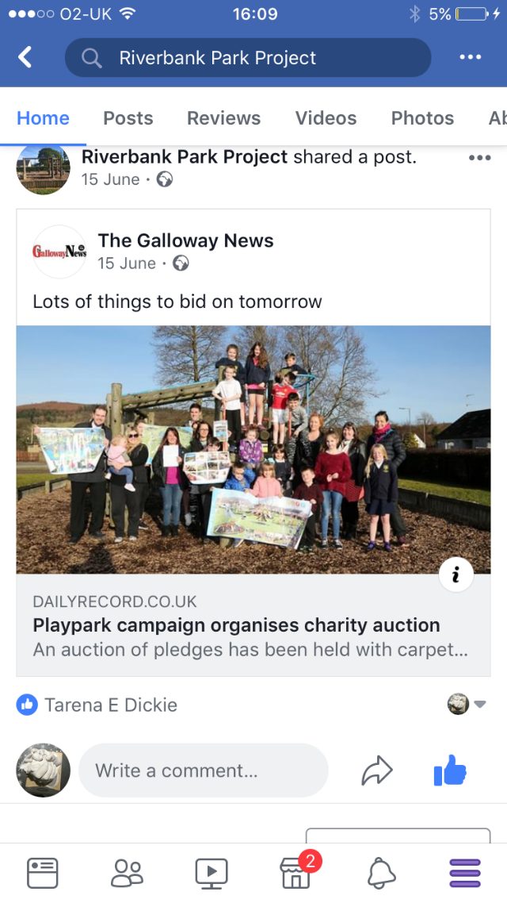
Individual Fundraisers

Slide 6
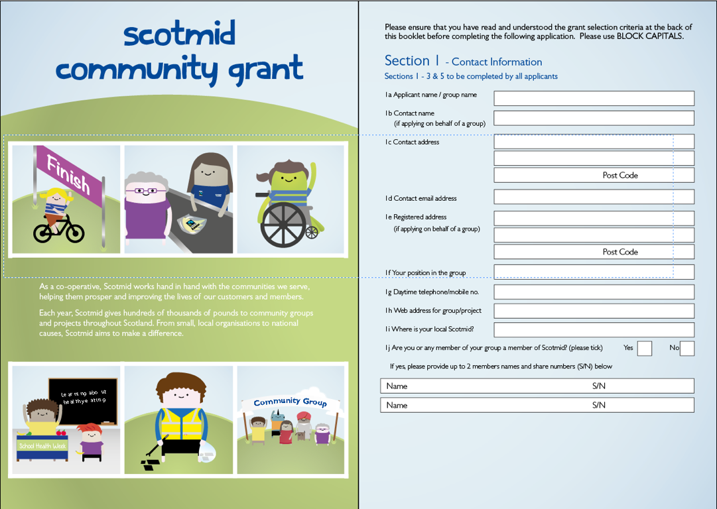
Community Grant Form
https://scotmid.coop/community-and-charity/supporting-local-communities/community-grant/

Slide 7
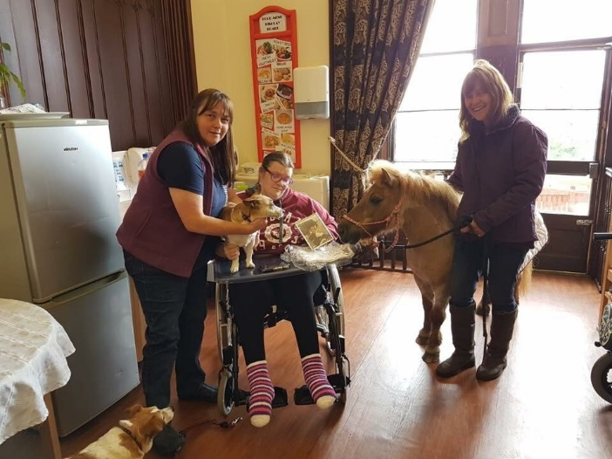
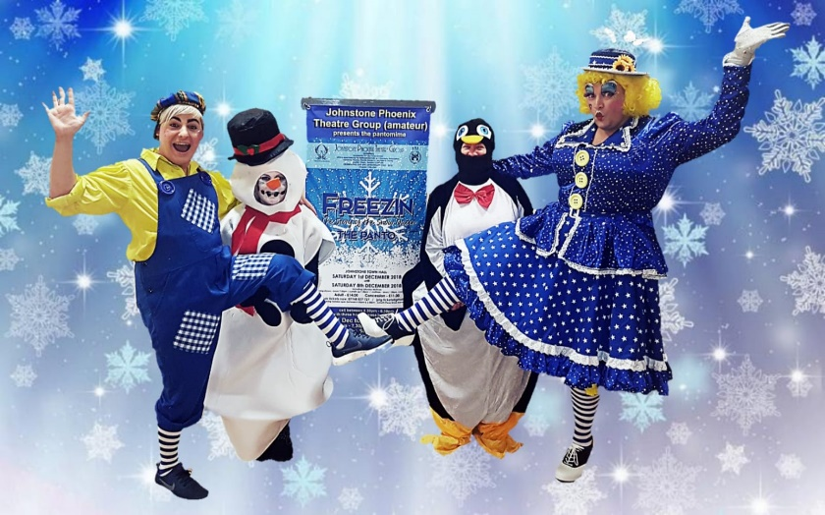
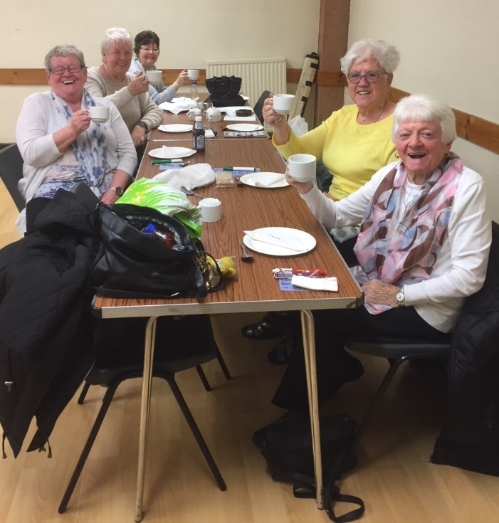
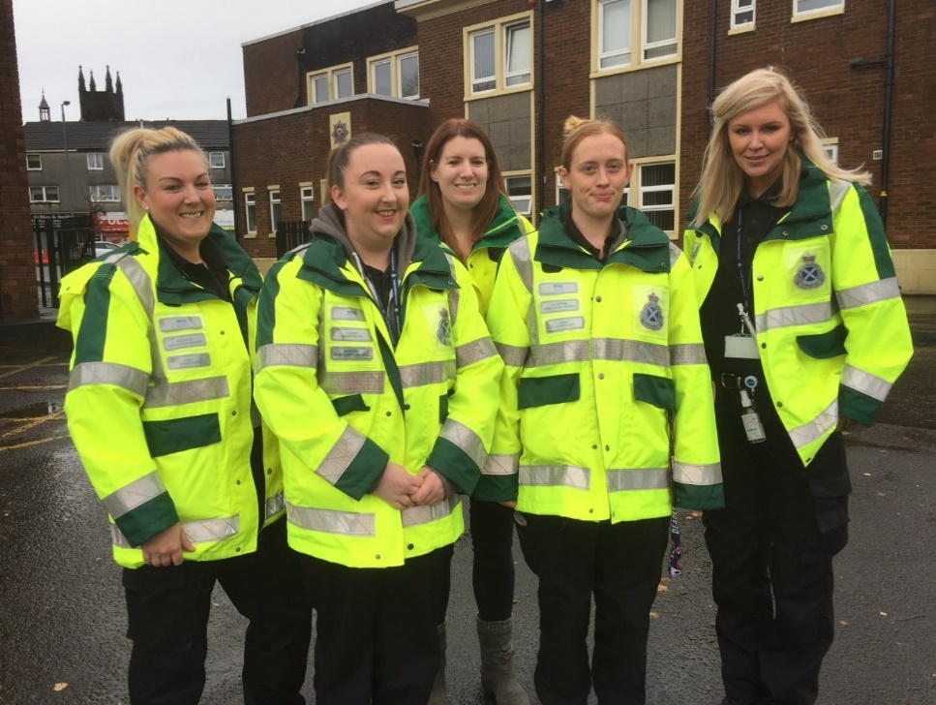
Community Grants

Slide 8
REGIONAL FUNDING
NATIONAL
REGIONAL
Local

Slide 9
Applications Open
https://scotmid.coop/how-does-community-connect-work-for-community-groups/
Close on 3rd March 2022

Slide 10
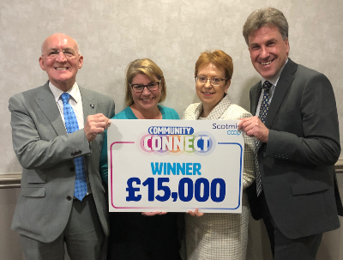
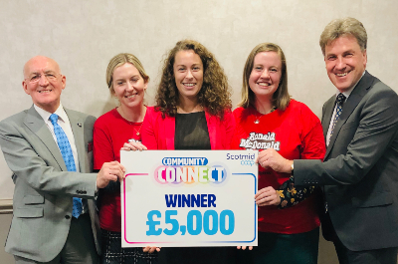
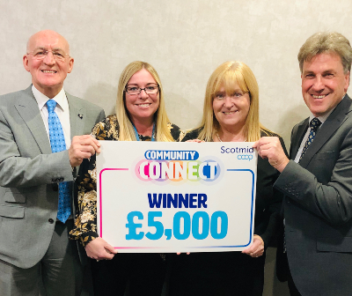

Slide 11
NATIONAL
REGIONAL
Local

Slide 12
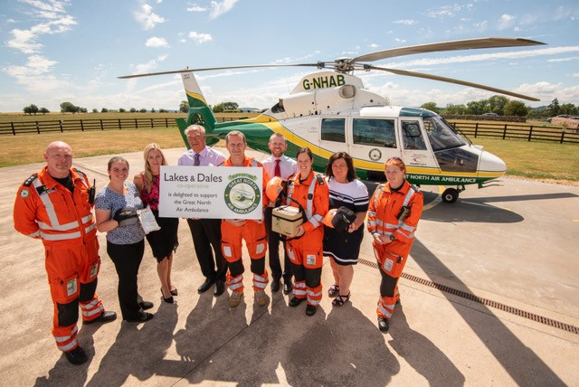
NATIONAL FUNDING

Slide 13
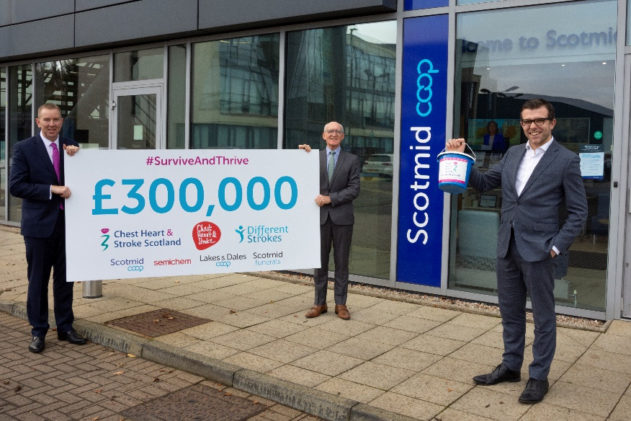
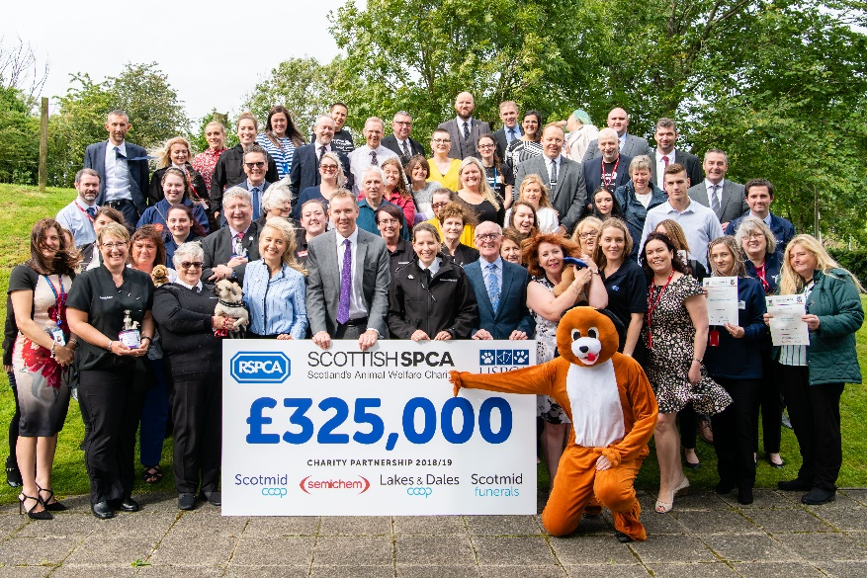
CHARITY OF THE YEAR

Slide 14
Happy to answer any questions…

